Slide 1
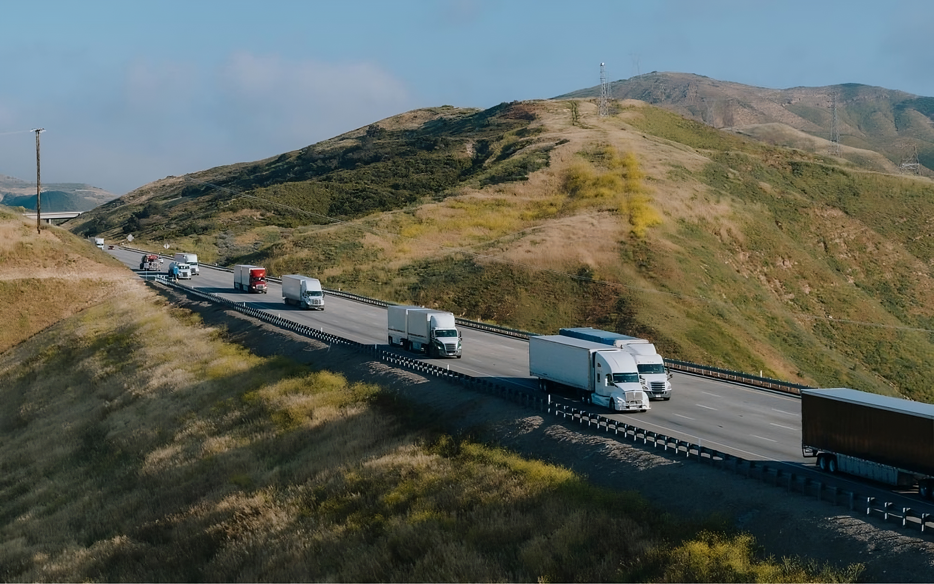
Uber Freight Interview Homework

Slide 2
Introduction
As part of the interview process, I was presented with two cases. The objective was to showcase my logic, methodology and understanding.

Slide 3
The methodology
01
02
03
Identify the problem
Research & Refine
Pseudocode
I start by defining the context of the problem, the issue it represents and why would the problem should be solved.
I then research if it have been solved before. Understand, refine and break it into simple and solvable subproblems. I consider multiple solutions and weight their pros and cons.
If the solution requires coding, I create an outline focusing on the logic.
06
05
04
Reflect
Implement
Testing
I reflect on my solution. Look into ways I could have made it better. So next time my work improves.
I implement my solution. Focusing on speed. After it’s implementation I refine. Searching for perfection takes a long time
I develop tests to validate my work or test my logic. This step can trade places with implementation.

Slide 4


Customer Demands
Data Analytics

Slide 5
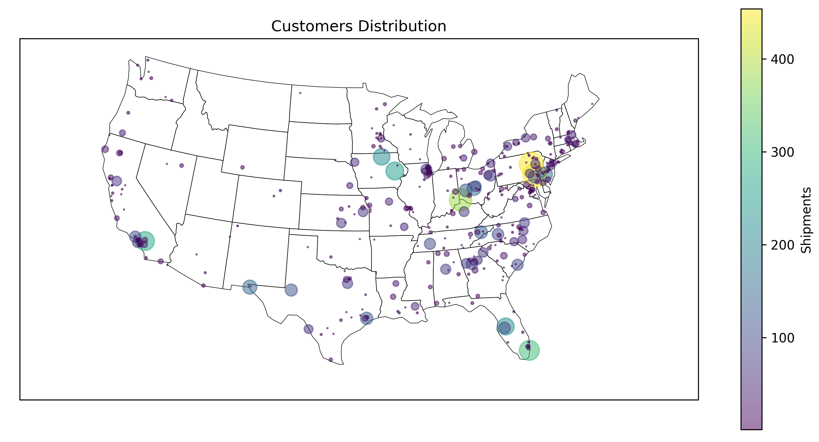
01.– Identifying the Problem
Context: The dataset contains 370 different customer cities. Each customer can only be served by one warehouse, and the warehouses have no capacity limit. The number of shipments per customer range from 1 to 454 and they are spread all over the United States.
Problem to solve: Find the two coordinates where the sum of the distance traveled is at it's minimum.
Why?: The most efficient location to open two warehouses will save millions of dollars.
Customer Demands

Slide 6
02.– Research & Refine
C
C
 | Lon
Lat | s | s | s
 | s | s | s
 | s | s | s
 | Lon
Lat | s₁ | s | s
 | s | s | s
 | s | s | s₂
S
C
C
2. Create a mesh and
calculate the sum of distances
3. Select the two lowest points and Iterate over them
Calculate the sum of distances to all the other customers from a source point
C
C
C
C
S₁
S₂
C
C
C
4. Distribute each customer by the closest point
Customer Demands

Slide 7
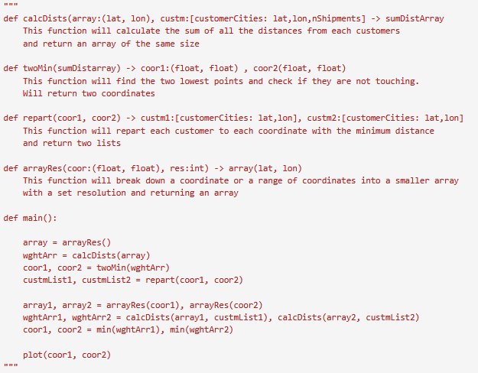
03.– Pseudocode
I designed the algorithm with the idea of being able feed it with the results obtained. That way the coordinates can be refined over various iterations.
Customer Demands

Slide 8
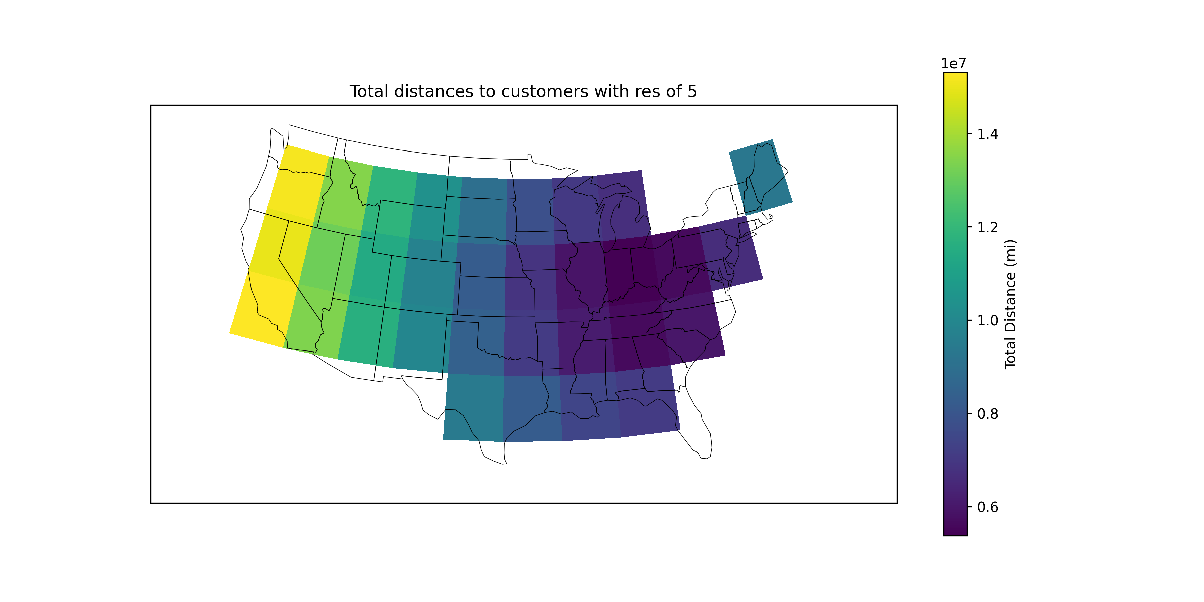
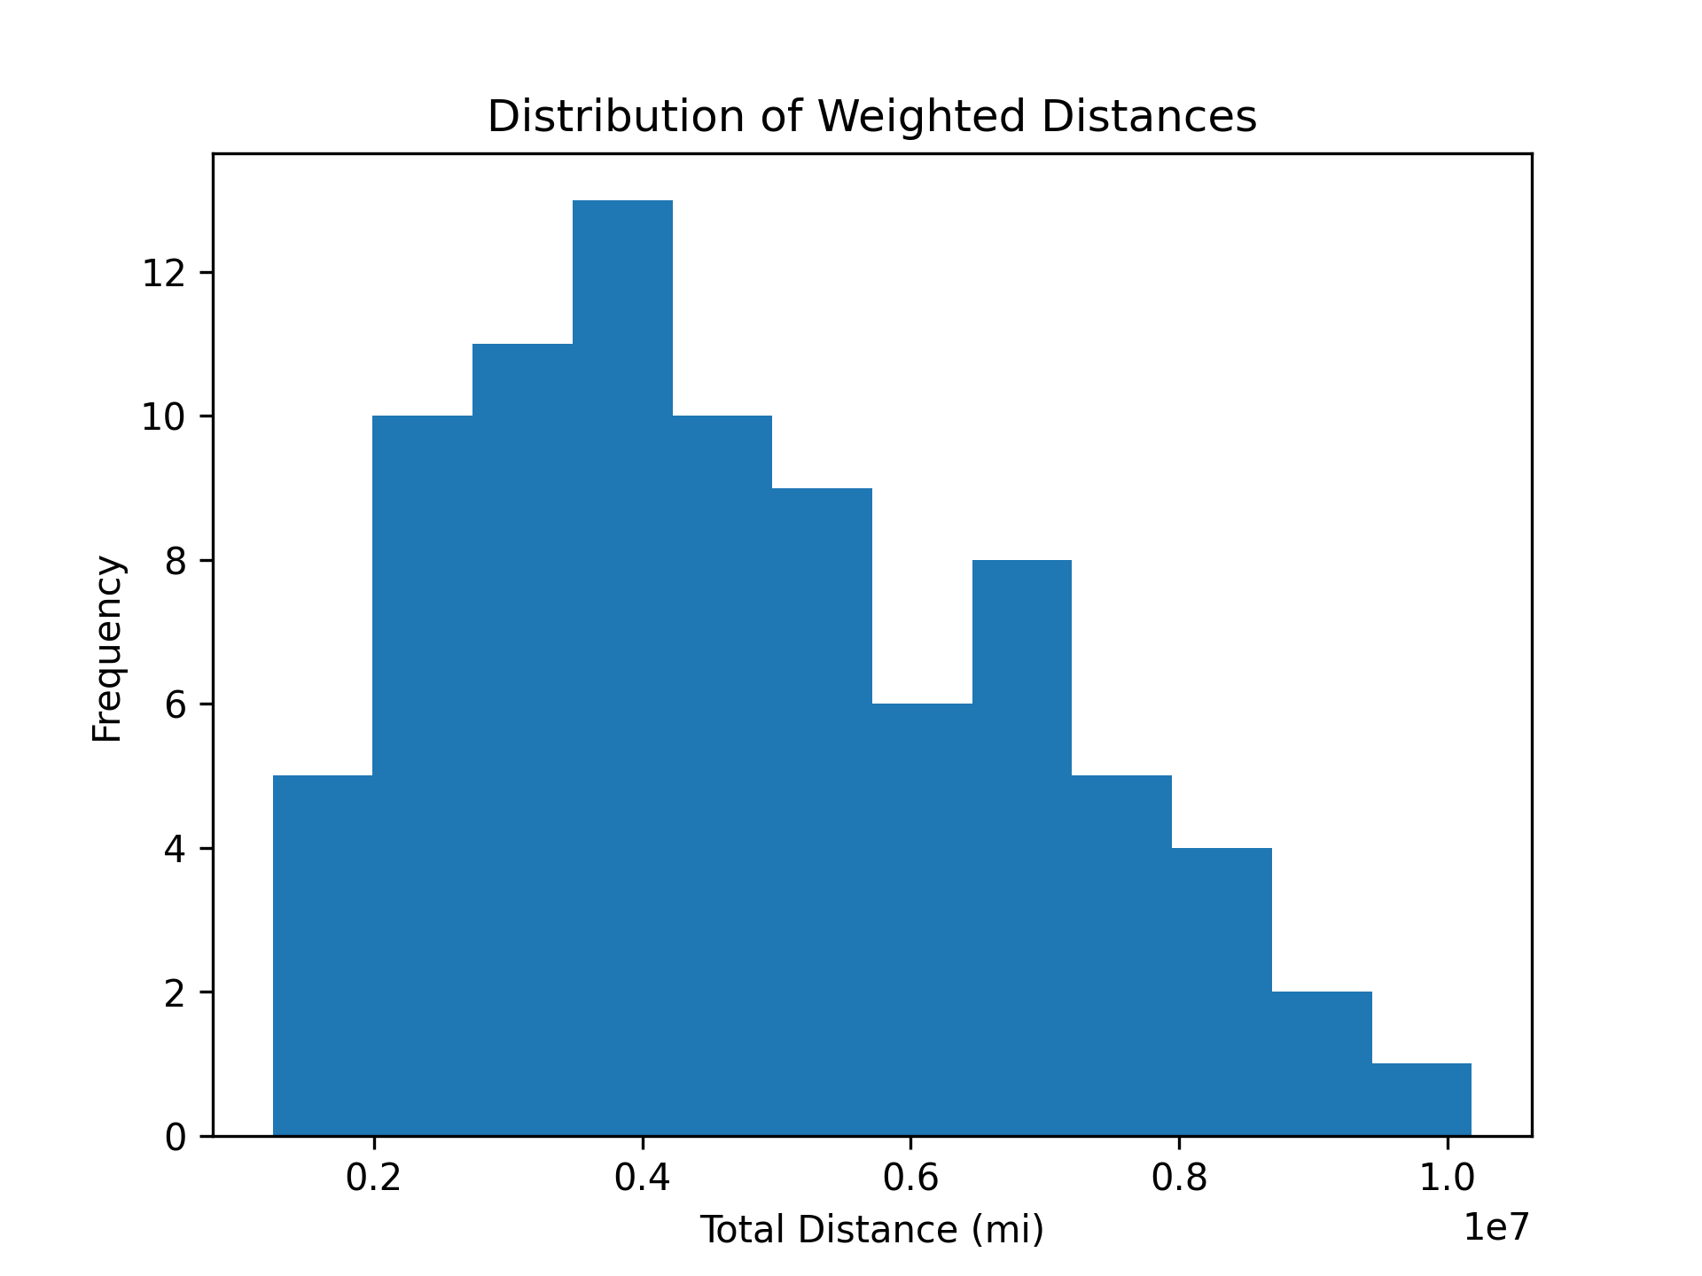
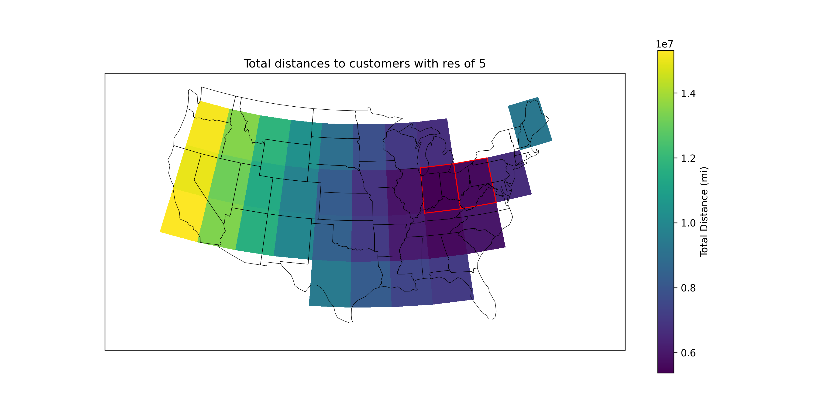
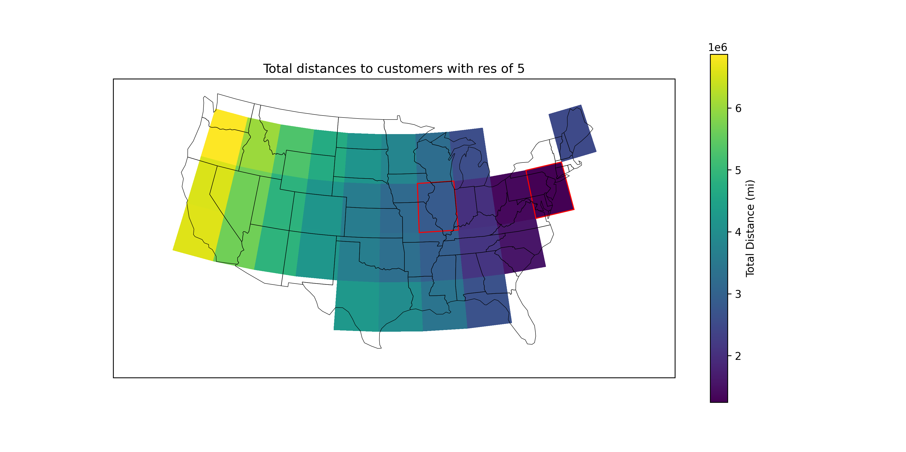
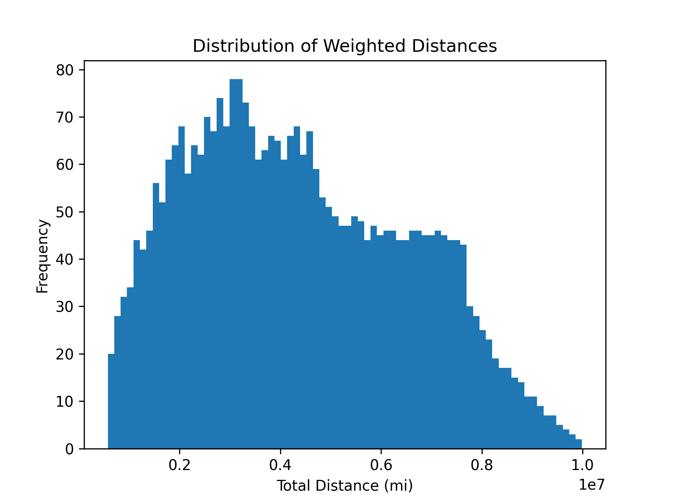
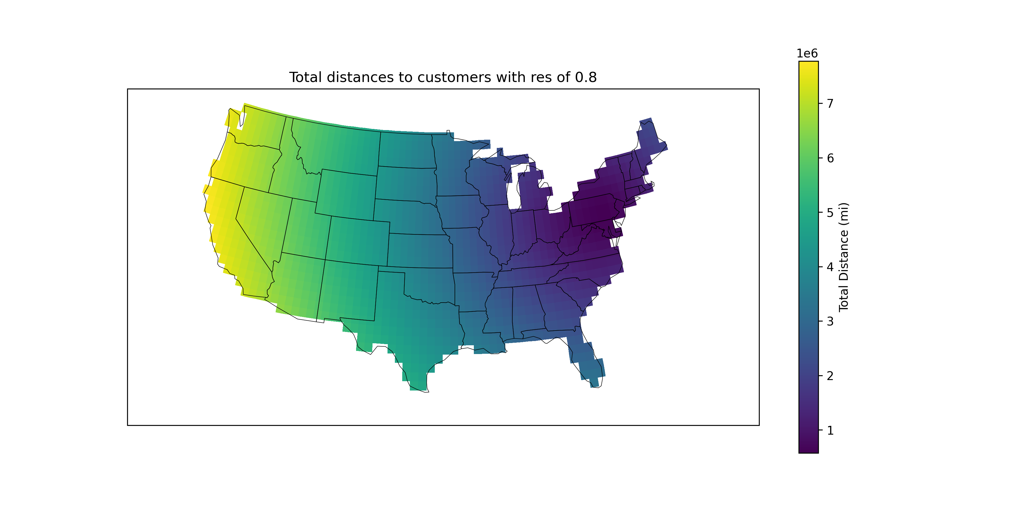


04.– Implementation
I ran the algorithm in various resolutions and with two iterations
Resolution of 5:
Resolution of 0.8:
Customer Demands

Slide 9
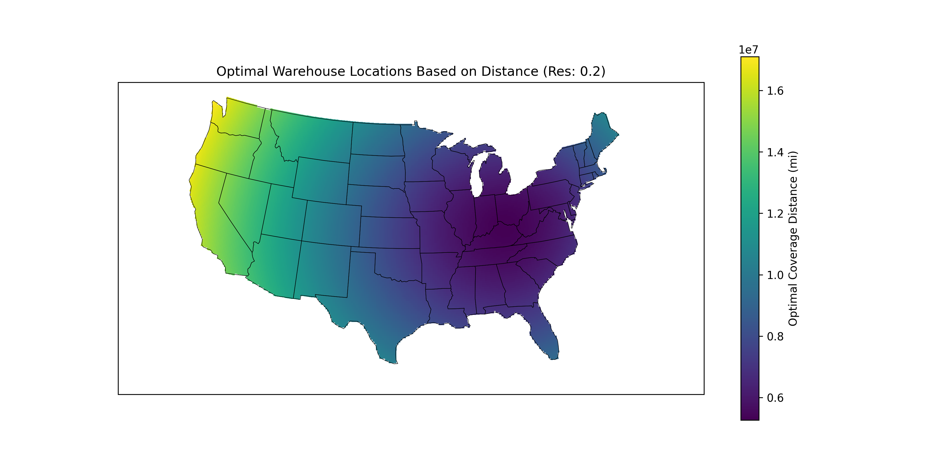

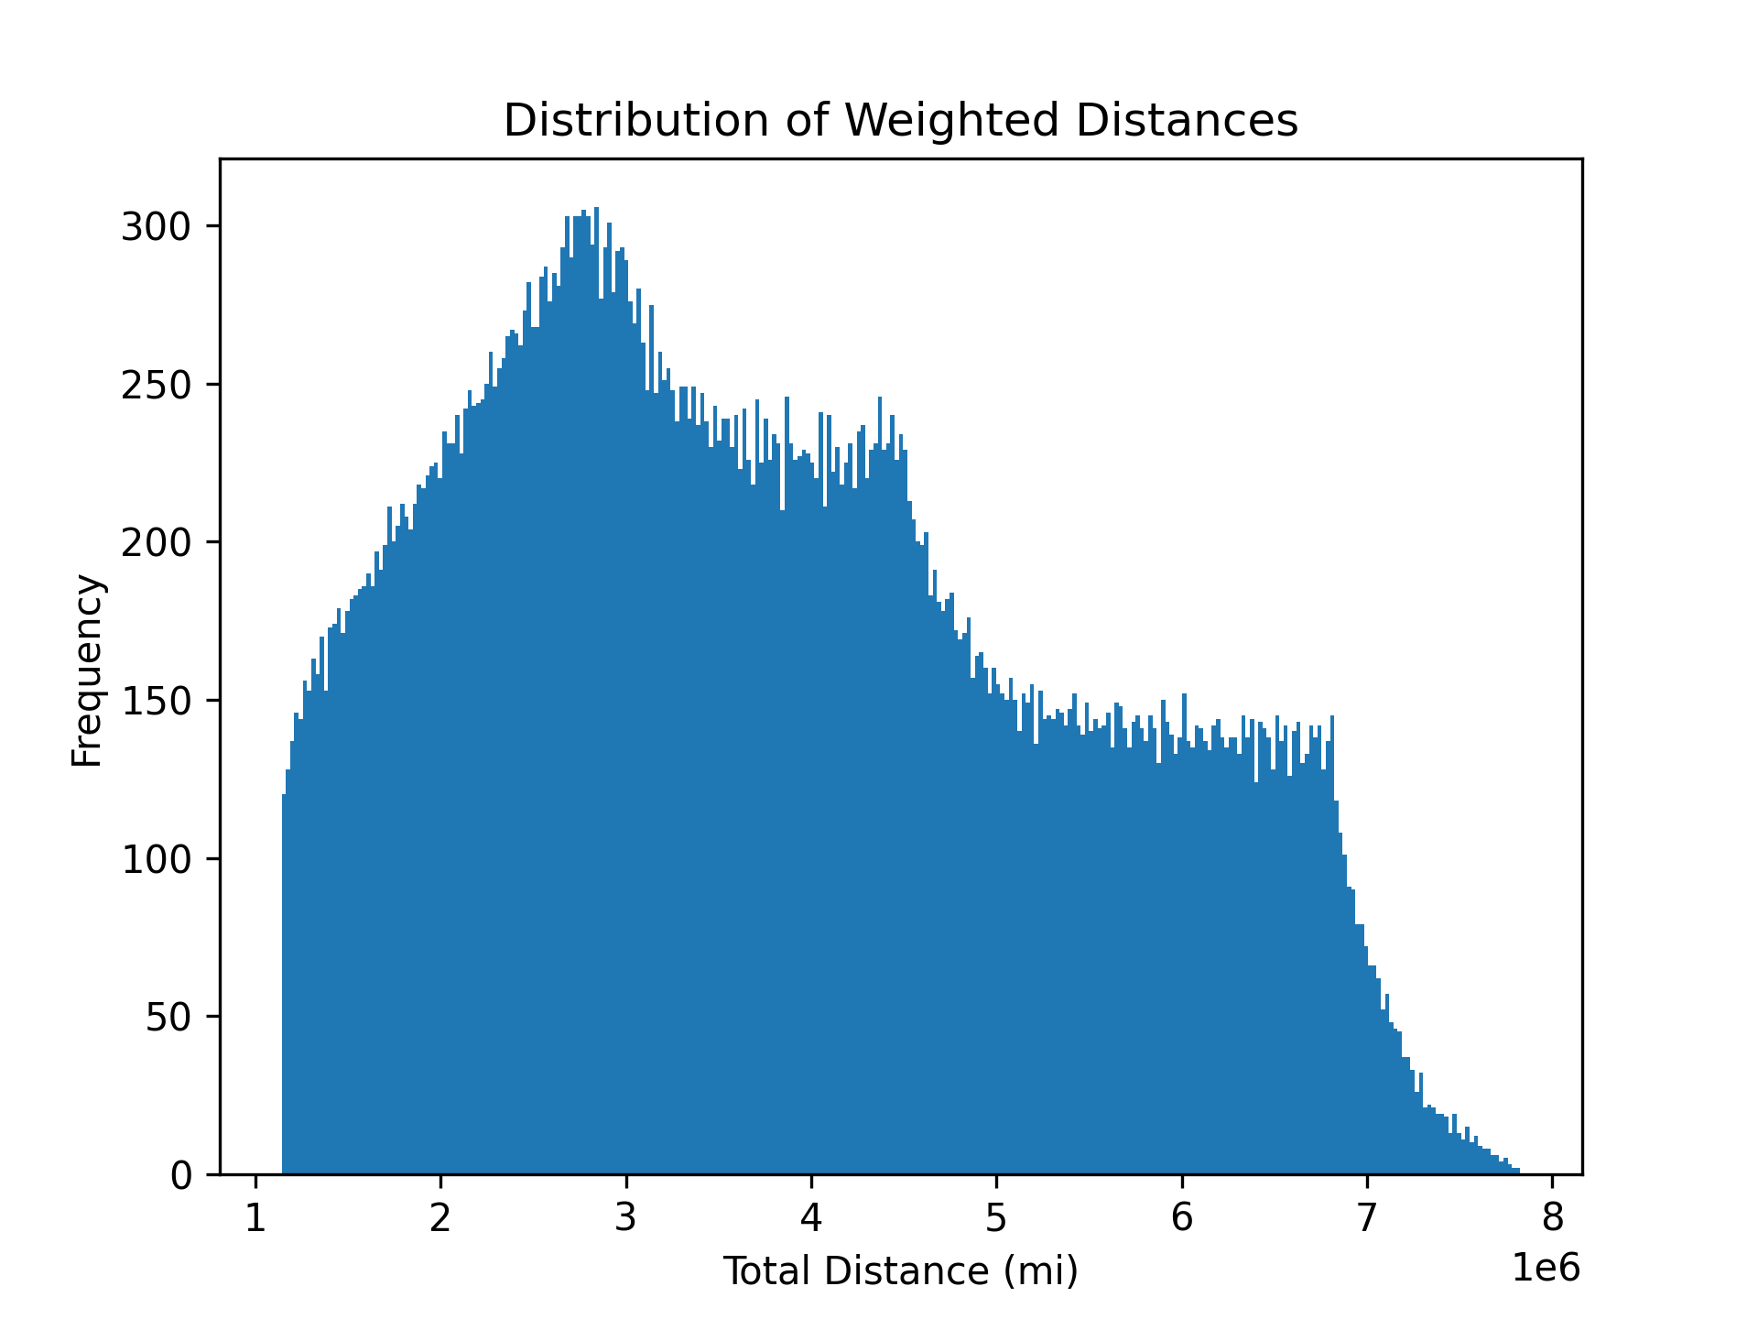
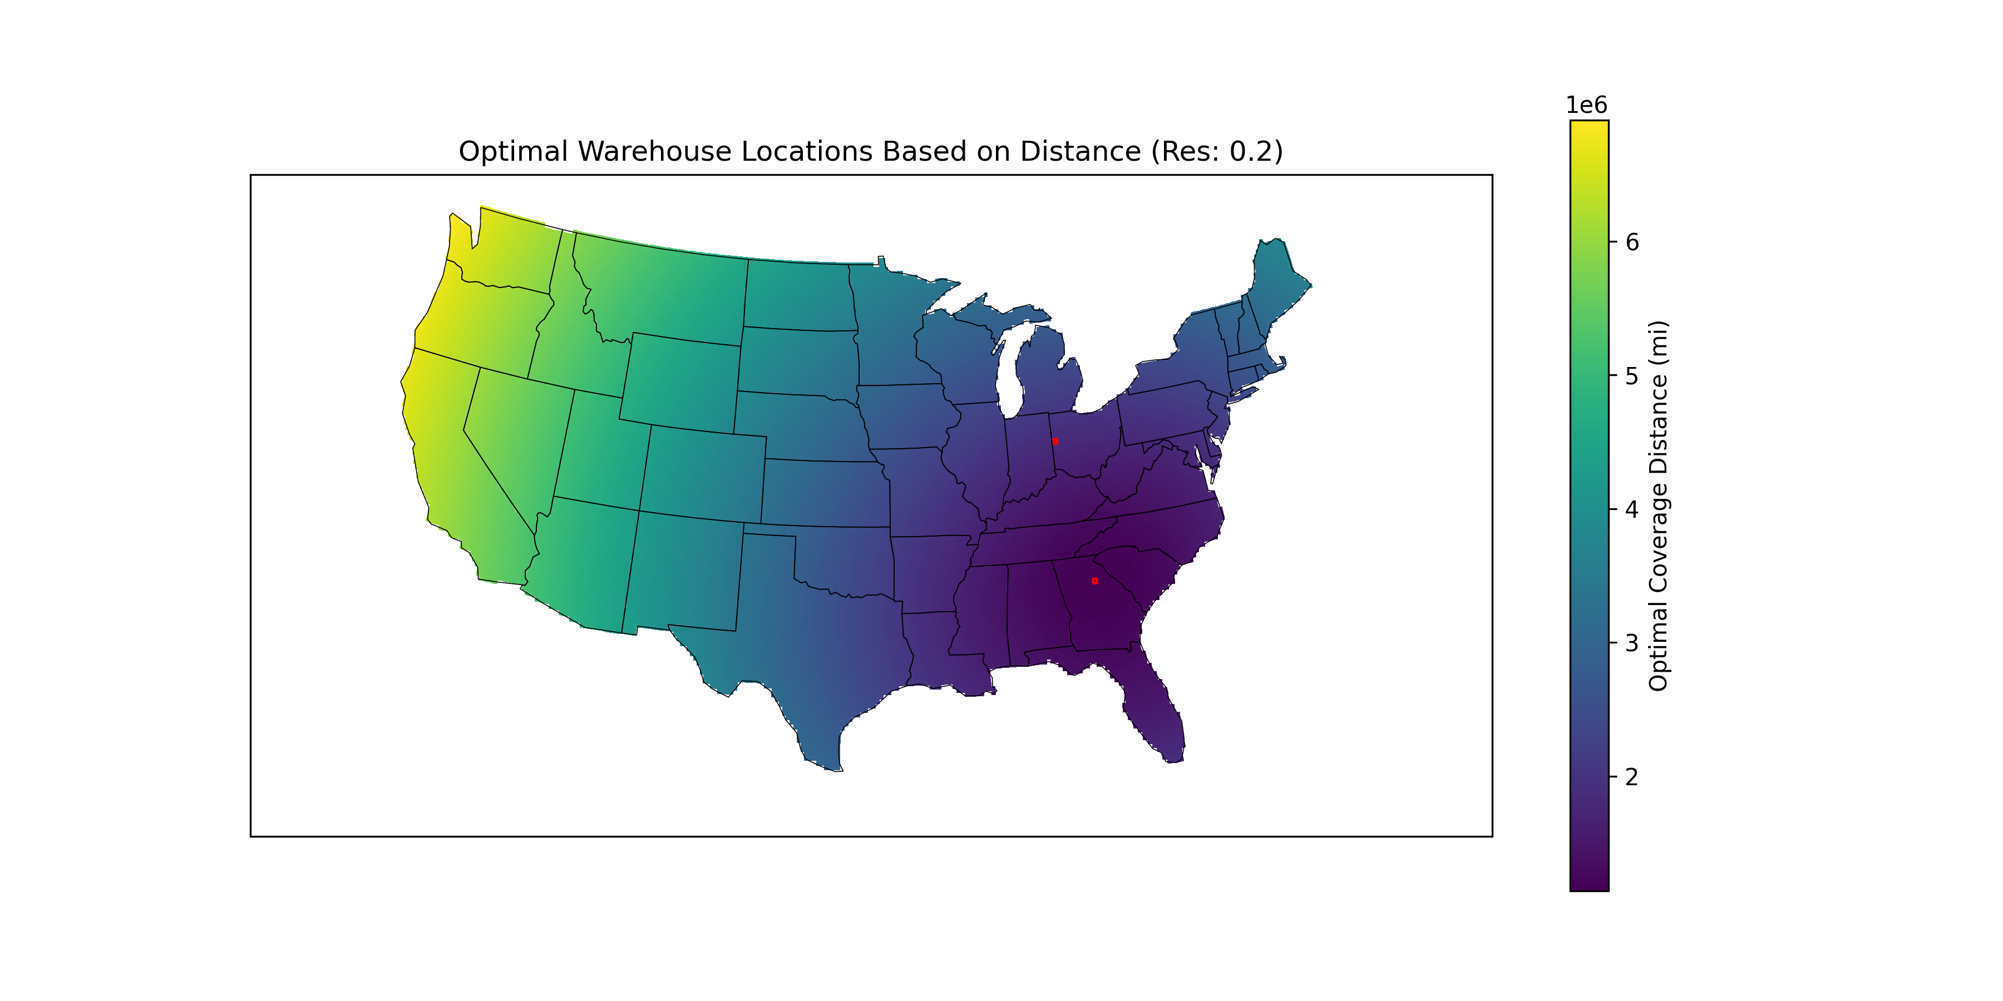
04.– Implementation
The last calculation was at the highest resolution, the results changed dramatically but stayed in east USA
Resolution of 0.2:
Customer Demands

Slide 10
05.– Testing
I ran a series of tests, comparing the results of to see differences between the two.
Chosen locations (lat, lon):
(36.80,-89.80), (40.00,-76.20)
Distance between points: 769.57 miles
Warehouse 1 stats:
Total cost of distance to customers: 6,094,341.07$
Total number of customers server: 224
Warehouse 2 stats:
Total cost of distance to customers: 9,692,855.44$
Total number of customers server: 146
Cost benefit over random selection:
Coordinate 1: -25.29%
Coordinate 2: -81.56%
Avg: -53.43%
Chosen locations (lat, lon):
(40.40,-84.60), (33.80,-83.40)
Distance between points: 459.92 miles
Warehouse 1 stats:
Total cost of distance to customers: 6,068,405.08$
Total number of customers server: 238
Warehouse 2 stats:
Total cost of distance to customers: 8,098,887.43$
Total number of customers server: 132
Cost benefit over random selection:
Performance 1: -41.17%
Performance 2: -64.70%
Avg: -52.94%
Customer Demands

Slide 11
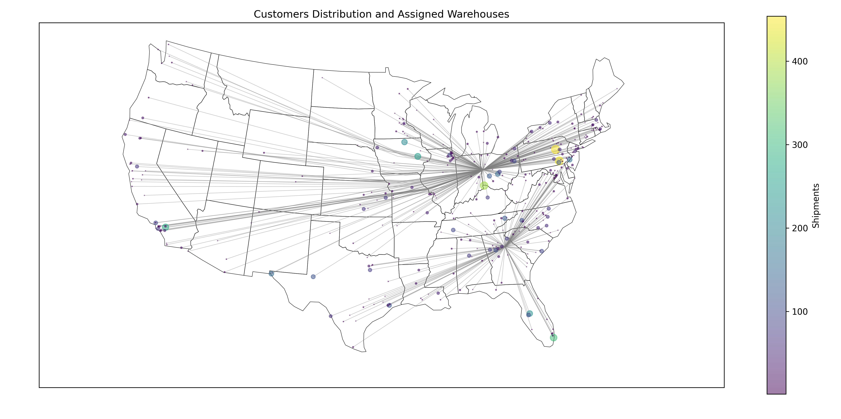
06.– Results
In the end, the higher resolution showed a small improvement. Translating into an improvement of -52.94% in costs over random coordinates selection and saving 1,619,904$ over the lower resolution.
Total Cost of the network:
14,167,292.51 $
Customer Demands

Slide 12
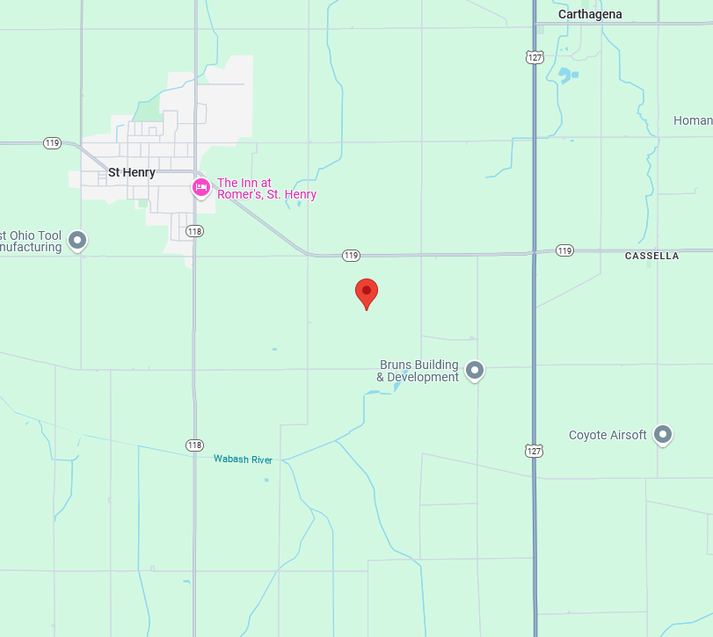
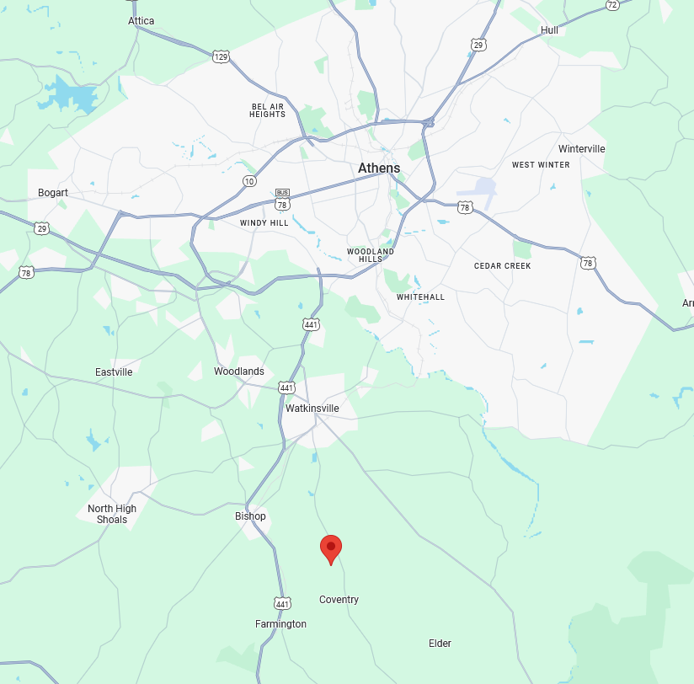
06.– Results
The two chosen locations where:
40°24'00.0"N 84°36'00.0"W
Near St Henry, Ohio
33°48'00.0"N 83°24'00.0"W
Farmington, Georgia, Near Athens
Customer Demands

Slide 13

01.– Identifying the Problem
Context: The dataset given needed to be transformed from a route level format to an individual shipment format. There are two modes of flow, outbound and inbound, which affects considerably the output.
Problem to solve: Transform the format from route level to shipment level considering the mode of flow
Why?: The unconsolidated route format showcases more detailed sequences, load modes and pickup times.
Data Analytics

Slide 14

02.– Research & Refine
To refine what I had to do I run under certain assumptions, i asked questions to the Logistics team, and researched of ways to calculate the latest pick-up times for an inbound route
Assumptions:
0 lb. < LTL (Less Than Truckload) <= 20,000 lb.
20,000 lb. < TL (Truckload) <= 45,000 lb.
LTL Avg 300 mi/day
Questions to answer:
What is the difference within an inbound route and an outbound route?
What is the difference within an LTL and a TL load?
How does dates affect earliest pickup times and latest pick times?
Data Analytics

Slide 15
02.– Research & Refine
What is the difference within an inbound route and an outbound route?
Aspect | Inbound Logistics | Outbound Logistics
Direction | Suppliers → Facility | Facility → Customers/Retailers
Stakeholders | Suppliers, procurement teams | Customers, retailers, delivery partners
Primary Goal | Ensure materials arrive on time and in full | Ensure products reach customers efficiently
Cost Focus | Minimize procurement/transportation costs | Optimize delivery speed and customer service
Challenges | Supplier delays, quality control | Last-mile delivery, returns management
Data Analytics

Slide 16
02.– Research & Refine
What is the difference within an LTL and a TL load?
Aspect | LTL | TL
Shipment Size | Smaller (partial trailer space) | Large (full trailer)
Cost Structure | Paid per "space used" + freight class | Flat rate for the entire trailer
Transit Time | Longer (due to multiple stops for consolidation/deconsolidation) | Faster (direct point-to-point delivery)
Handling | More handling (transferred between hubs) | Minimal handling (sealed at origin)
Risk of Damage | Higher (multiple stops and transfers) | Lower (single load, no transfers)
Pricing Factors | Weight, dimensions, freight class, zones | Distance, fuel, trailer type
Best For | Small businesses, partial loads, cost-sensitive shipments | Large businesses, urgent/priority shipments, high-value goods
Data Analytics

Slide 17
02.– Research & Refine
How does dates affect earliest pickup times and latest pick times?
Aspect | Outbound Consolidation | Inbound Consolidation
Pick Date Driver | Determined by the slowest/latest order in the batch. | Determined by supplier availability and route efficiency.
Flexibility | Facility controls when orders are staged (but must wait for the slowest). | Carrier must adapt to external supplier schedules.
Complexity | Internally managed (within your facility). | Externally constrained (dependent on suppliers).
Example | Waiting for 3 customer orders to be packed before a truck can depart. | A truck visiting 5 suppliers across a region, each with their own ready times.
Data Analytics

Slide 18
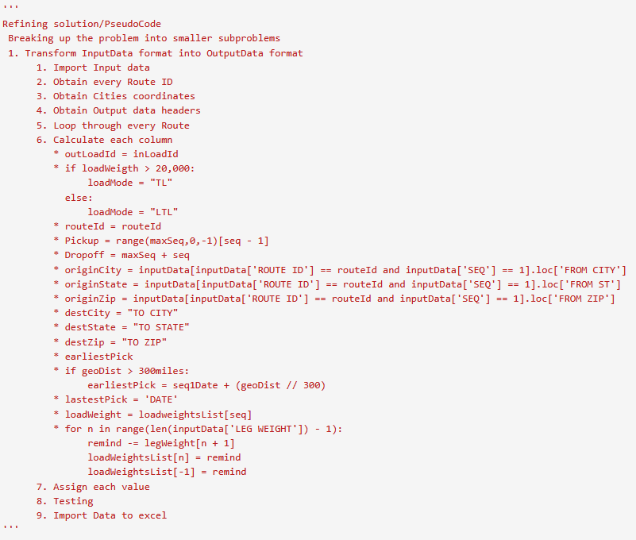
03.– Pseudocode
The code was straight forward. The idea was to loop through the whole list designating the various columns considering the mode of flow.
Data Analytics

Slide 19
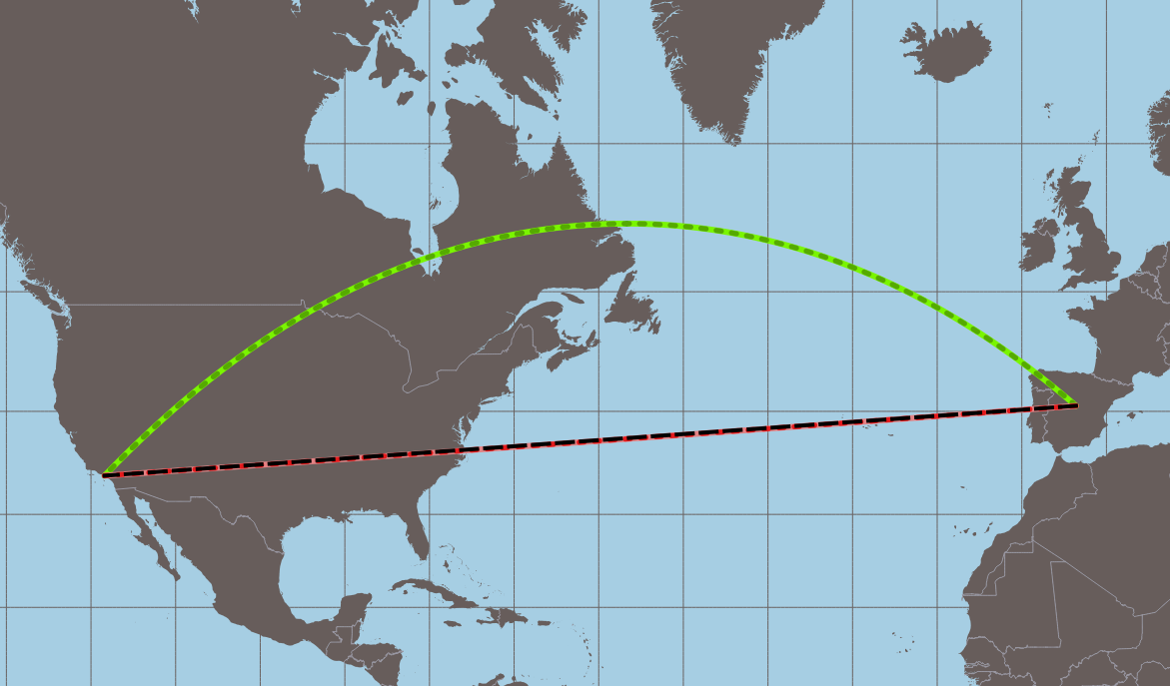
04.– Implementation
The implementation was trickier than anticipated, mainly due to my approach of estimating the latest pickup date for inbound routes. Which needed to first calculate geodesic distances and dividing the result by the average LTL miles driven by day.
Data Analytics

Slide 20
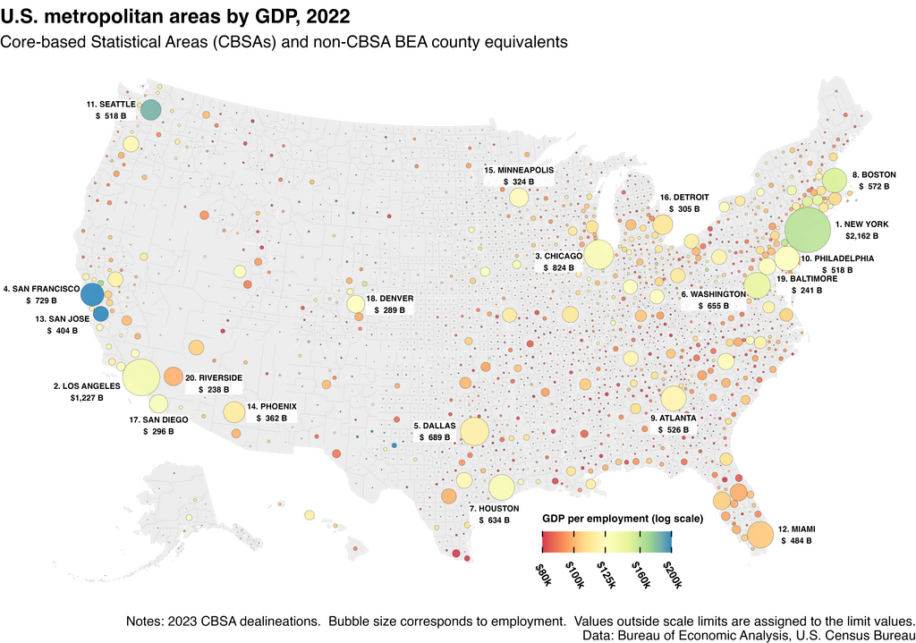
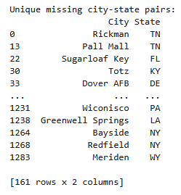
04.– Implementation
For my approach to work I needed all the cities present in the database with coordinates.
I obtained a US cities database with over 32,000 cities and towns. But still lacked all the cities present in the input
Data Analytics

Slide 21
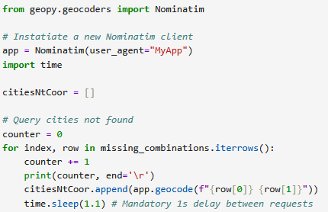
04.– Implementation
Not being discouraged I implemented a module which queried websites to obtain the data that I was missing. Ending in only 48 entries not found.
Data Analytics

Slide 22
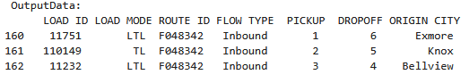
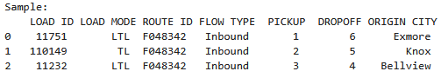
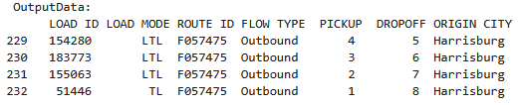
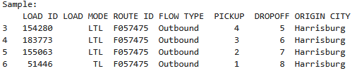
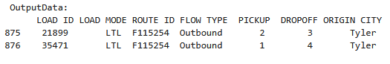
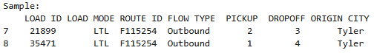
05.– Testing
To validate the data obtained I solved 3 randomly chosen routes and compared the results with my code.
Data Analytics

Slide 23
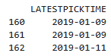
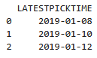
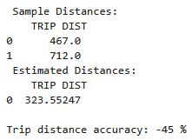
05.– Testing
Distance calculations fell short every time, this is due to the simplistic approach of geodesics, which only considers the shortest path around the globe, not real-world highways. Meaning that it will be short of a day in short trips and 4 days in longer trips. This only affects inbound trips
This could be solved with distance algorithms which consider USA highway system.
Output:
Sample:
Data Analytics

Slide 24
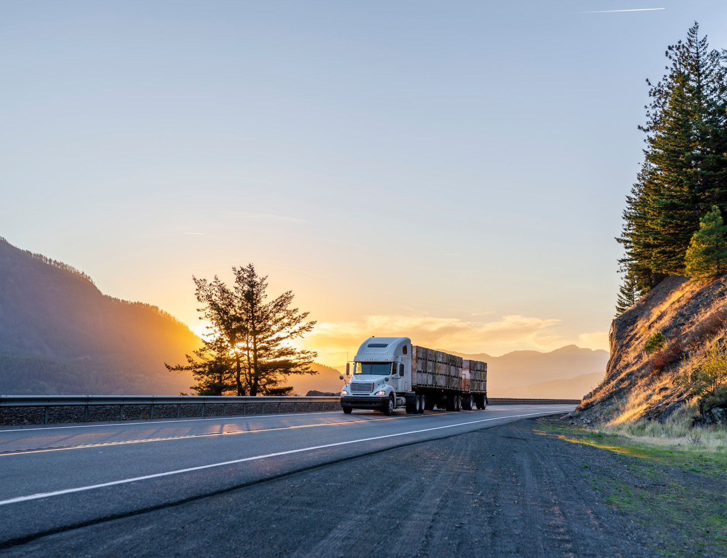
Thank you!
Edgar Tijerina
81-19-07-06-27
Edgarhumberto1999@gmail.com
LinkedIn: EdgarHTT

